Slide 1


OPERATIONAL ANALYTICS AND INVESTIGATING METRIC SPIKE
Paul Damein K
05-01-2025
PROJECT- 3

Slide 2


PROJECT DESCRIPTION:
Operational analytics is crucial for improving a company's operations by extracting valuable insights from collected data. As a lead Data Analyst at a company like Microsoft, I collaborated with the operations, support, and marketing teams. With the help of my advanced SQL skills, I examine their data to pinpoint areas for improvement and provided the company understand with insights into unexpected changes in key metrics.
My project focuses on two main case studies. The first, Job Data Analysis, aims to analyse operational metrics related to job reviews. The second, Investigating Metric Spike, seeks to understand user engagement and activity patterns. Both case studies leverage advanced SQL techniques to derive valuable insights and address specific business questions. This project will provide actionable recommendations to optimize operations and enhance user experience.

Slide 3
PROJECT APPROACH:
1. DATABASE SETUP:
Create Database and Table: A database is created, and tables are defined according to the given structure. Also, import CSV files into MySQL Workbench.
2. ANALYSIS EXECUTION:
In the analysis phase, I am going to use advanced SQL techniques to answer the questions asked for case studies.
Job Data Analysis: In this part, using SQL aggregation functions and series analysis, I worked on calculating average scores, identification trends, and anomaly detection in job reviews.
Investigating Metric Spike: User engagement trends are analyzed by aggregating activity data. Spikes are detected by comparing current data against historical averages.
3. REPORT PREPARATION:
Compile Findings: The analysis results were summarized in a detailed report. This report, created in PPT presentation format, summarized the key findings by table trends and making actionable recommendations. The clear and crisp presentation of insights, driven by data, had to be given to the leadership team for meaningful decision-making and improvements in operations and user experience.

Slide 4


Tech-stack used:
The tech-stack used for the project is MySQL workbench,
community server version 8.0.
We also used Microsoft Excel for cleaning the data as shown in the tutorial on how to load large data to MySQL.
The data files we in csv. Format

Slide 5
1) CASE STUDY 1: JOB DATA ANALYSIS
Creating a table named job-data with the following columns:
Job_id: (unique identifier of jobs)
Actor_id: (Unique identifier of actor)
Event: (the type of event (decision/skip/transfer))
Language: (The language of the content)
Time_spent: (time spent to review the job in seconds)
Org: (the organization of the actor)
Ds: (The date in the format yyyy/mm/dd - stored as text)

Slide 6
Query for creating DB and loading data into Mysql
Create Database for core project 3:
Loading Data into MySQL server:

Slide 7
Query for loading data into the table Job_data:

Slide 8
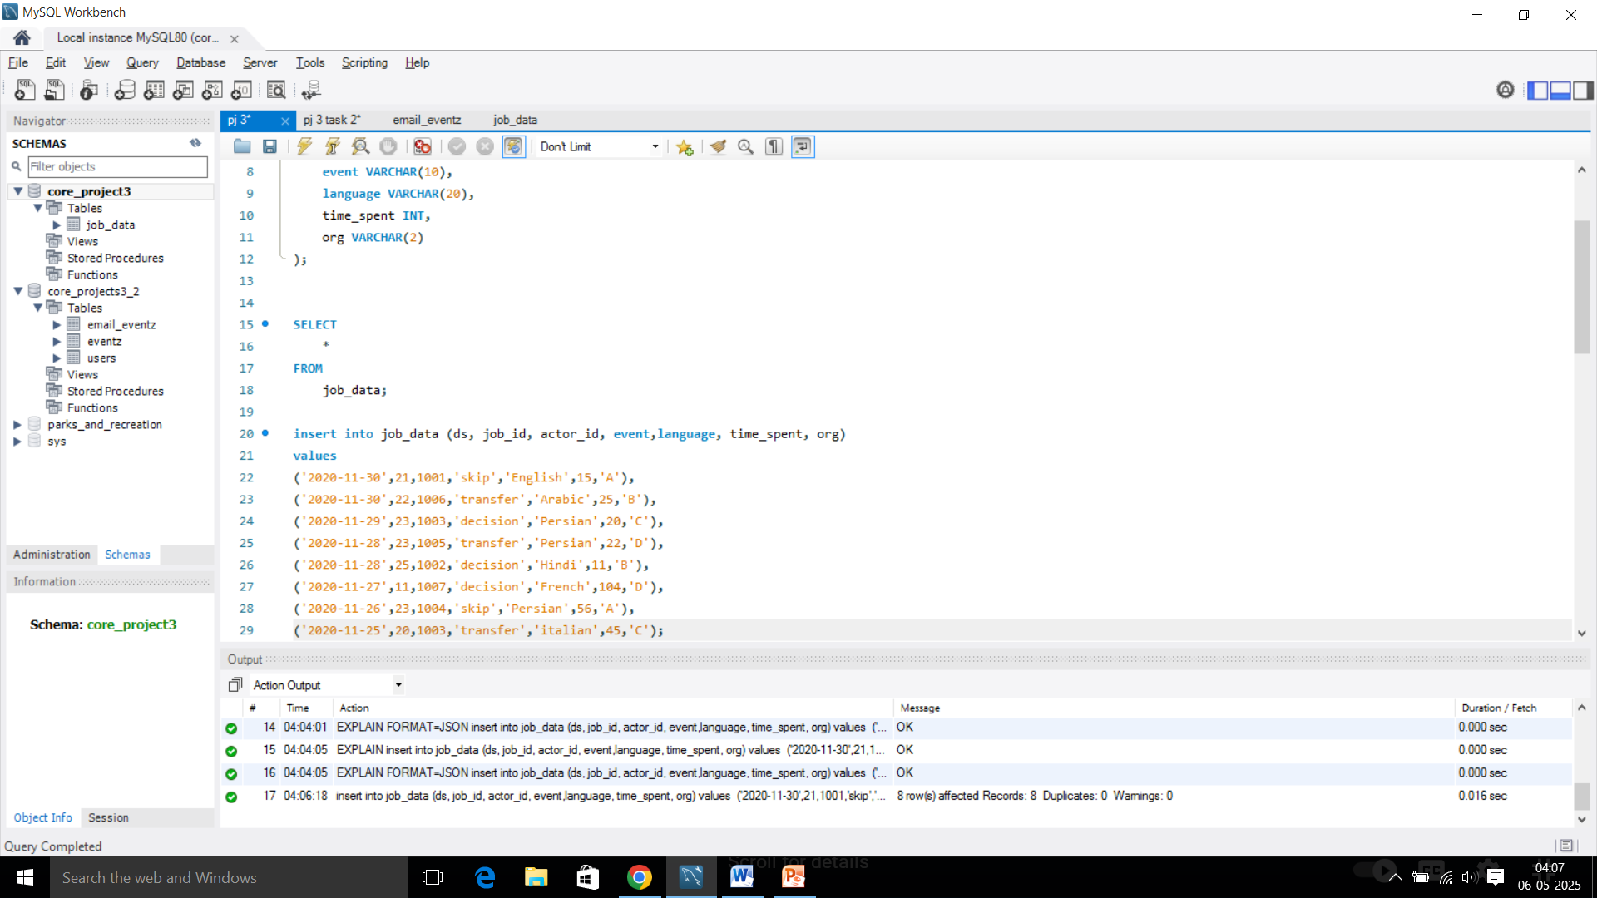
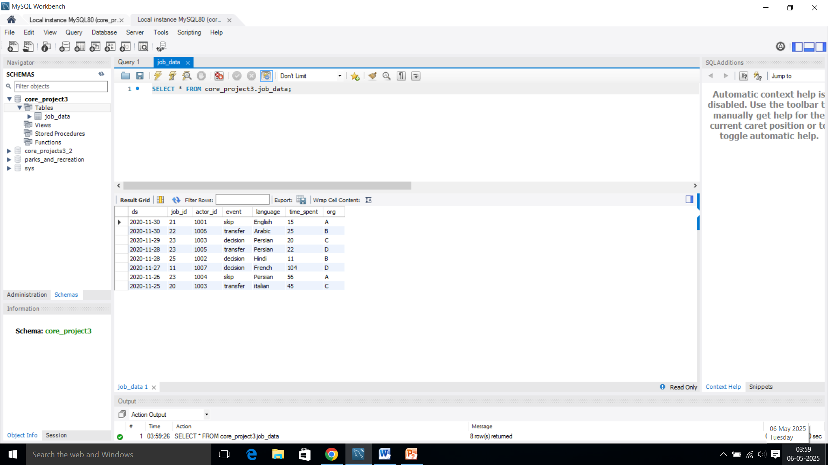
Result:
Query:
Output:

Slide 9
CASE STUDY 1: TASKS
A. JOBS REVIEWED OVER TIME
Objective: Calculate the number of jobs reviewed per hour for each day in November 2020.
Your Task: Write an SQL query to calculate the number of jobs reviewed per hour for each day in November 2020.
SQL Query:
Insight:
From the table, we can observe that 0.01 jobs reviewed per hour for each day in November 2020.
The highest jobs reviewed is on 28th November 2020 with 218.16 per hour.

Slide 10
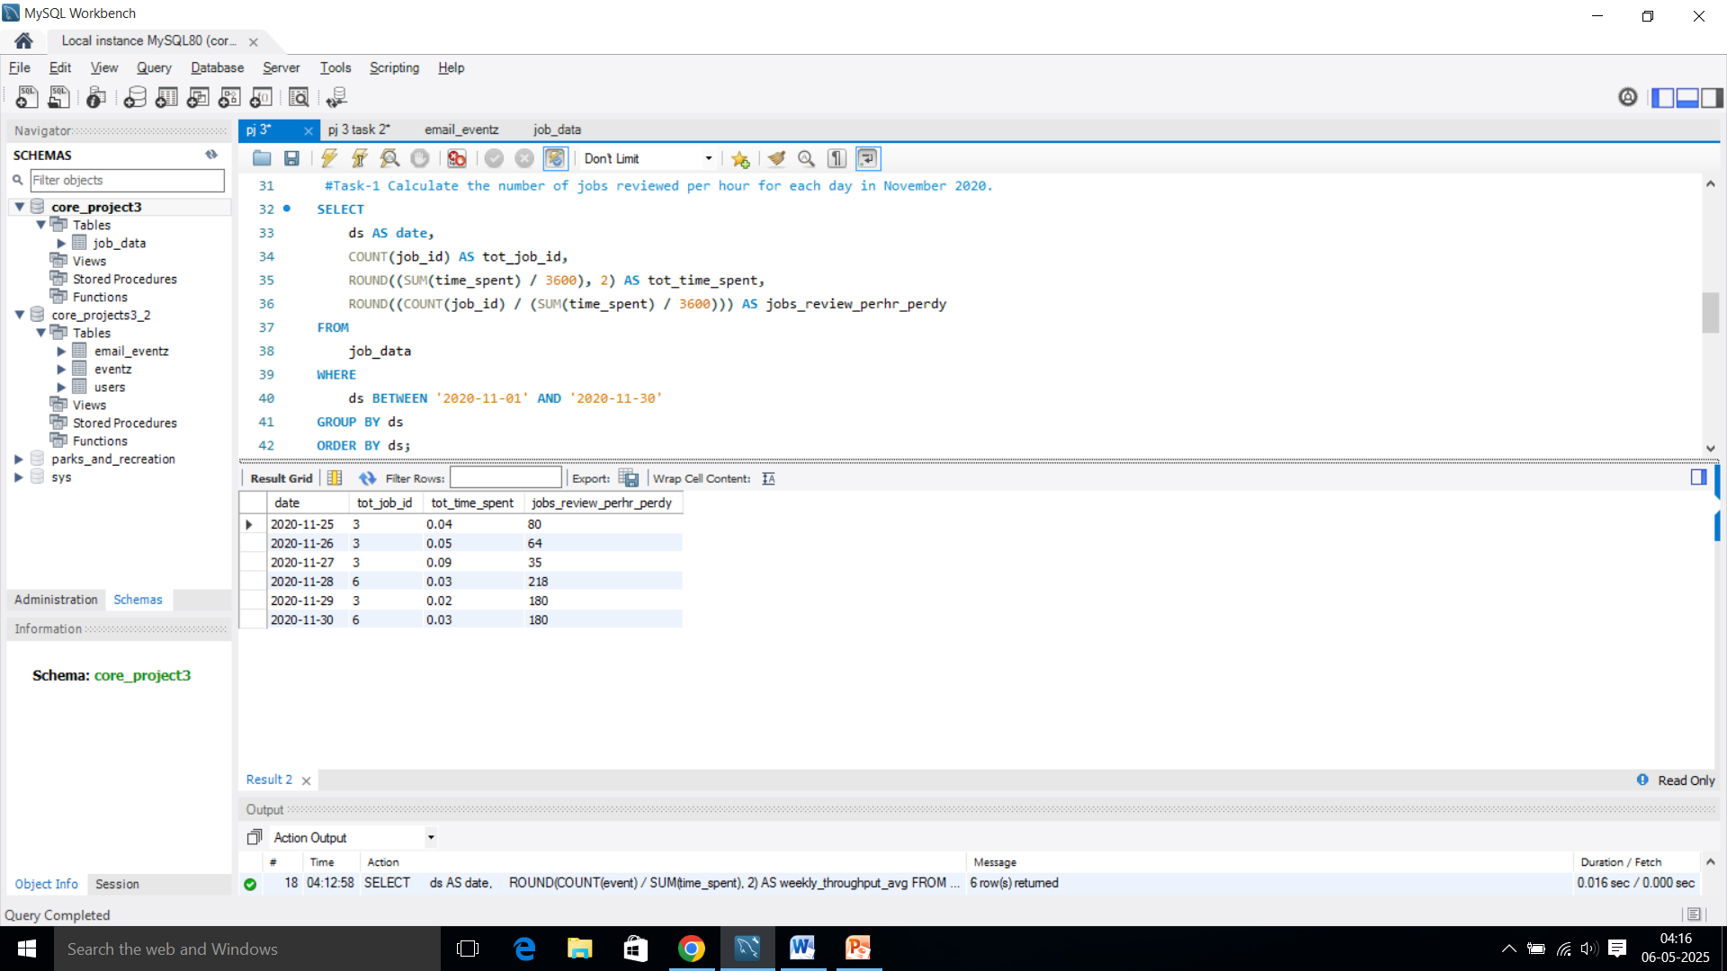
Result:
Query:
Output:

Slide 11
B. Throughput Analysis:
Objective: Calculate the 7-day rolling average of throughput (number of events per second).
Your Task: Write an SQL query to calculate the 7-day rolling average of throughput. Additionally, explain whether you prefer using the daily metric or the 7-day rolling average for throughput, and why.
SQL Query:
Insights:
The 7-day rolling average of throughput is between 0.01 to 0.06.
The weekly average throughput is 0.03 events per second.
7 day rolling average will normally preferable for analyzing throughput to avoid fluctuating trends.

Slide 12
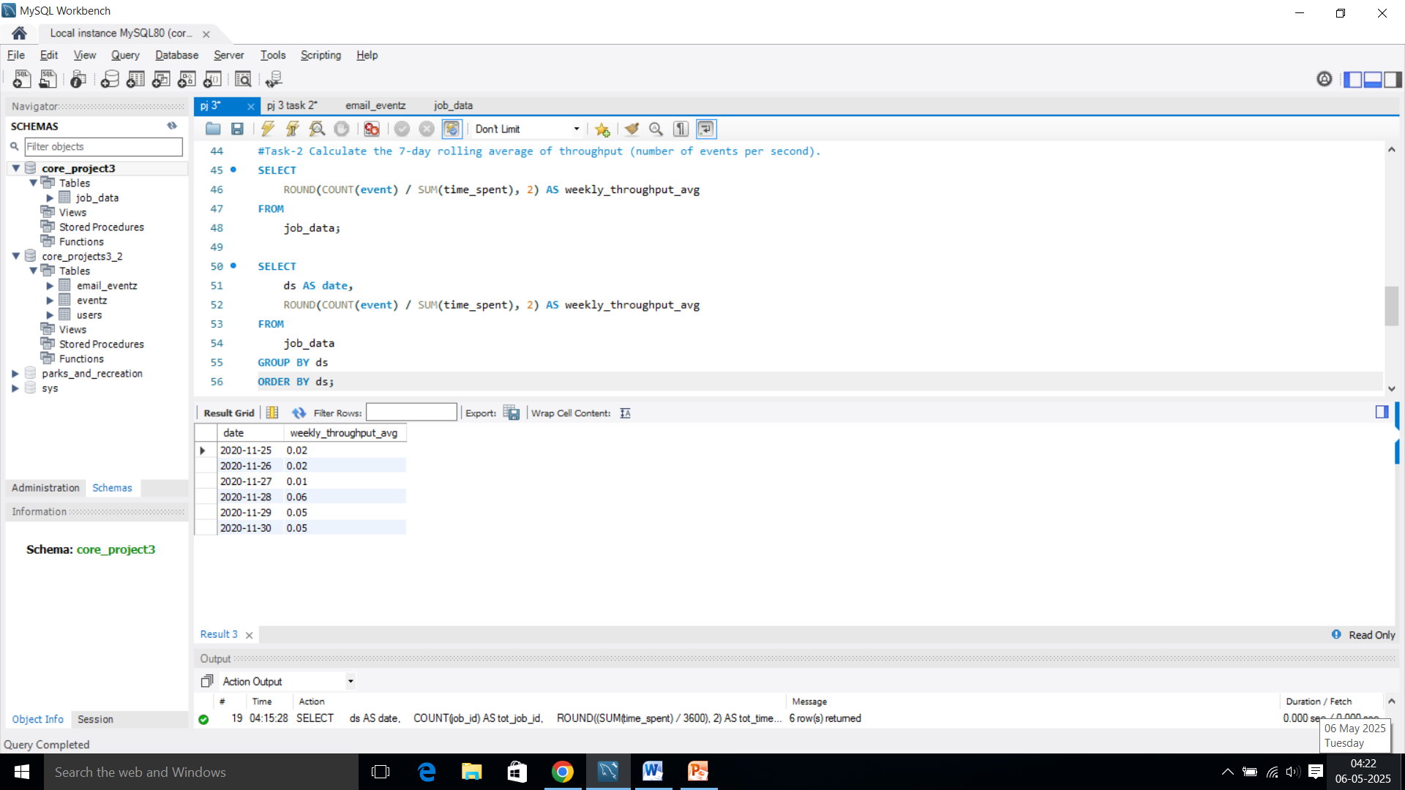
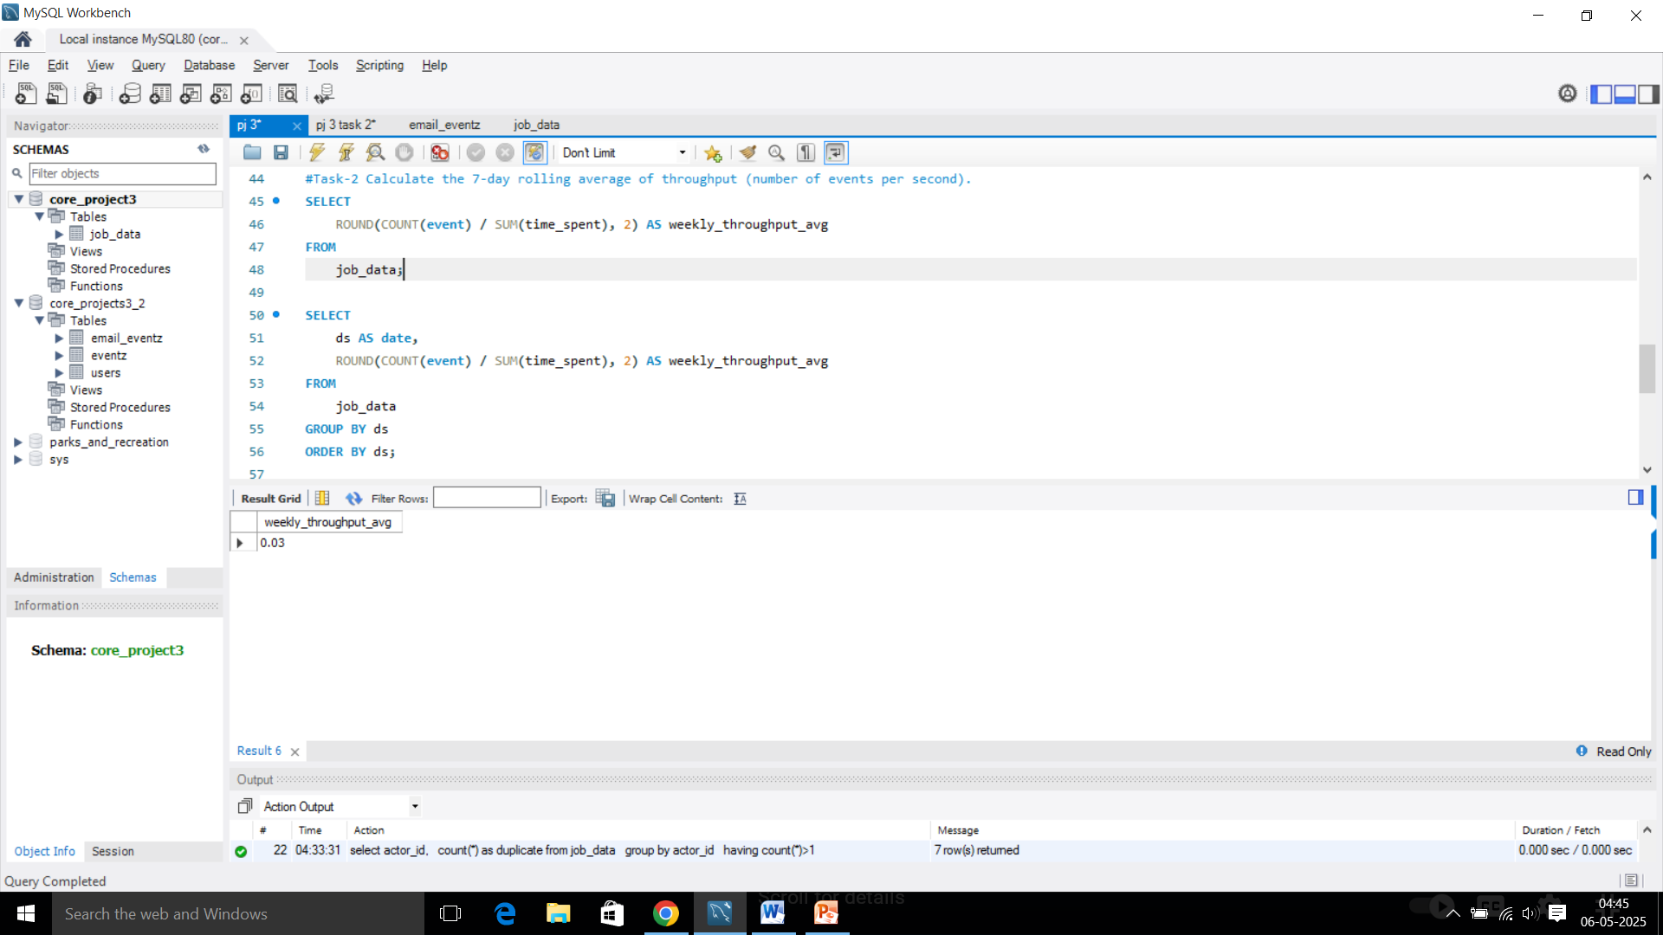
Result:
Query:
Output:

Slide 13
Daily Metric Vs 7-day Rolling Average:
The 7-day rolling average is often better for analysing throughput.
Here's a simpler way to put it in pointers:
Here's a simpler way to put it in pointers:
Daily data can jump around a lot due to short-term things.
A 7-day rolling average smooth these ups and downs.
This gives a clearer picture of the overall trend in throughput over time.
So, the rolling average provides a more stable and comprehensive view of performance than daily numbers.

Slide 14
C. Language Share Analysis:
Objective: Calculate the percentage share of each language in the last 30 days.
Your Task: Write an SQL query to calculate the percentage share of each language over the last 30 days.
SQL Query:
Insights:
Persian is the most frequent language, representing 37.50% of the data.
English, Arabic, Hindi, French, and Italian are used equally, each at 12.50%.
This analysis is based on a total of 8 data points.

Slide 15
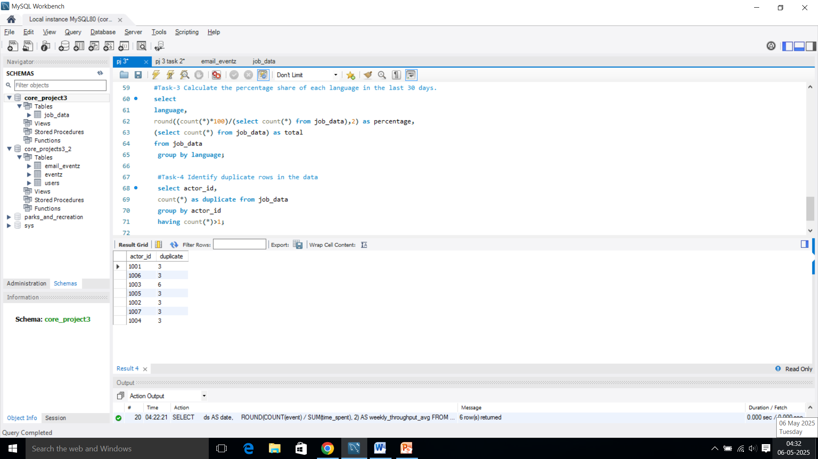
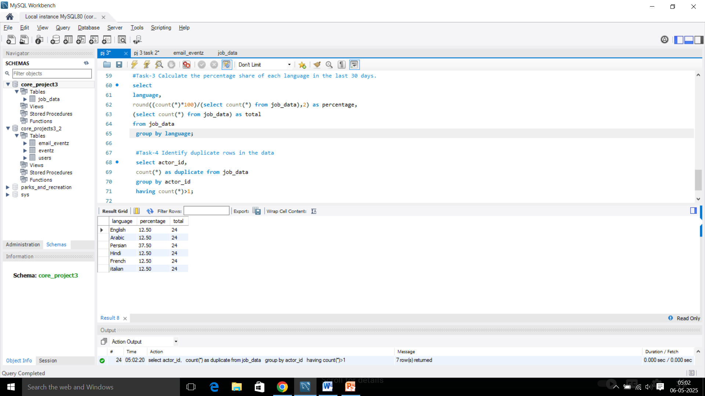
Result:
Query:
Output:

Slide 16
D. Duplicate Rows Detection:
Objective: Identify duplicate rows in the data.
Your Task: Write an SQL query to display duplicate rows from the job_data table.
SQL Query:
Insights:
Out of 8 total rows, there are 2 duplicate rows.
The actor_id 1003 is duplicated.

Slide 17
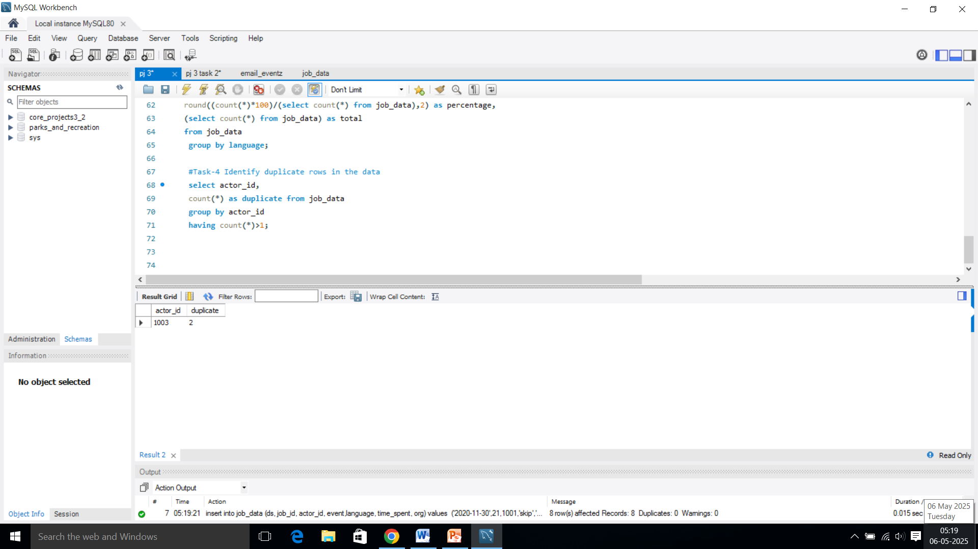
Result:
Query:
Output:

Slide 18
Case Study 2: Investigating Metric Spike
You will be working with three tables:
users: Contains one row per user, with descriptive information about that user’s account.
events: Contains one row per event, where an event is an action that a user has taken (e.g., login, messaging, search).
email_events: Contains events specific to the sending of emails.

Slide 19
Query for creating DB and loading data into Mysql
Create Database for core project 3:
Loading Data into MySQL server, TABLE-1:

Slide 20
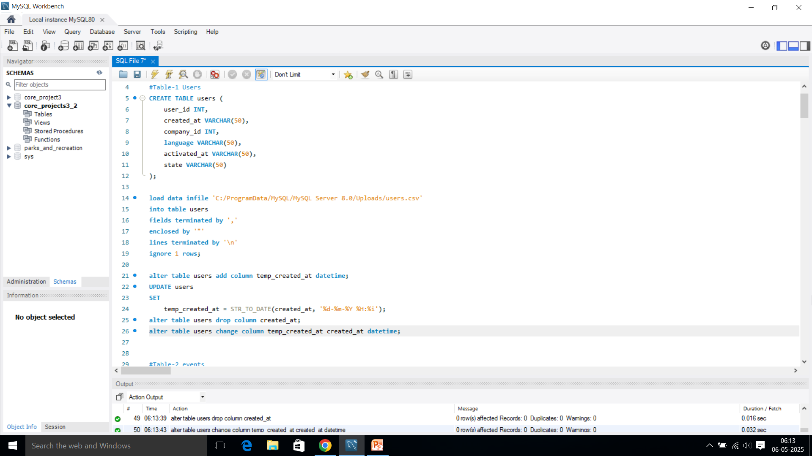
RESULT:
Query:

Slide 21
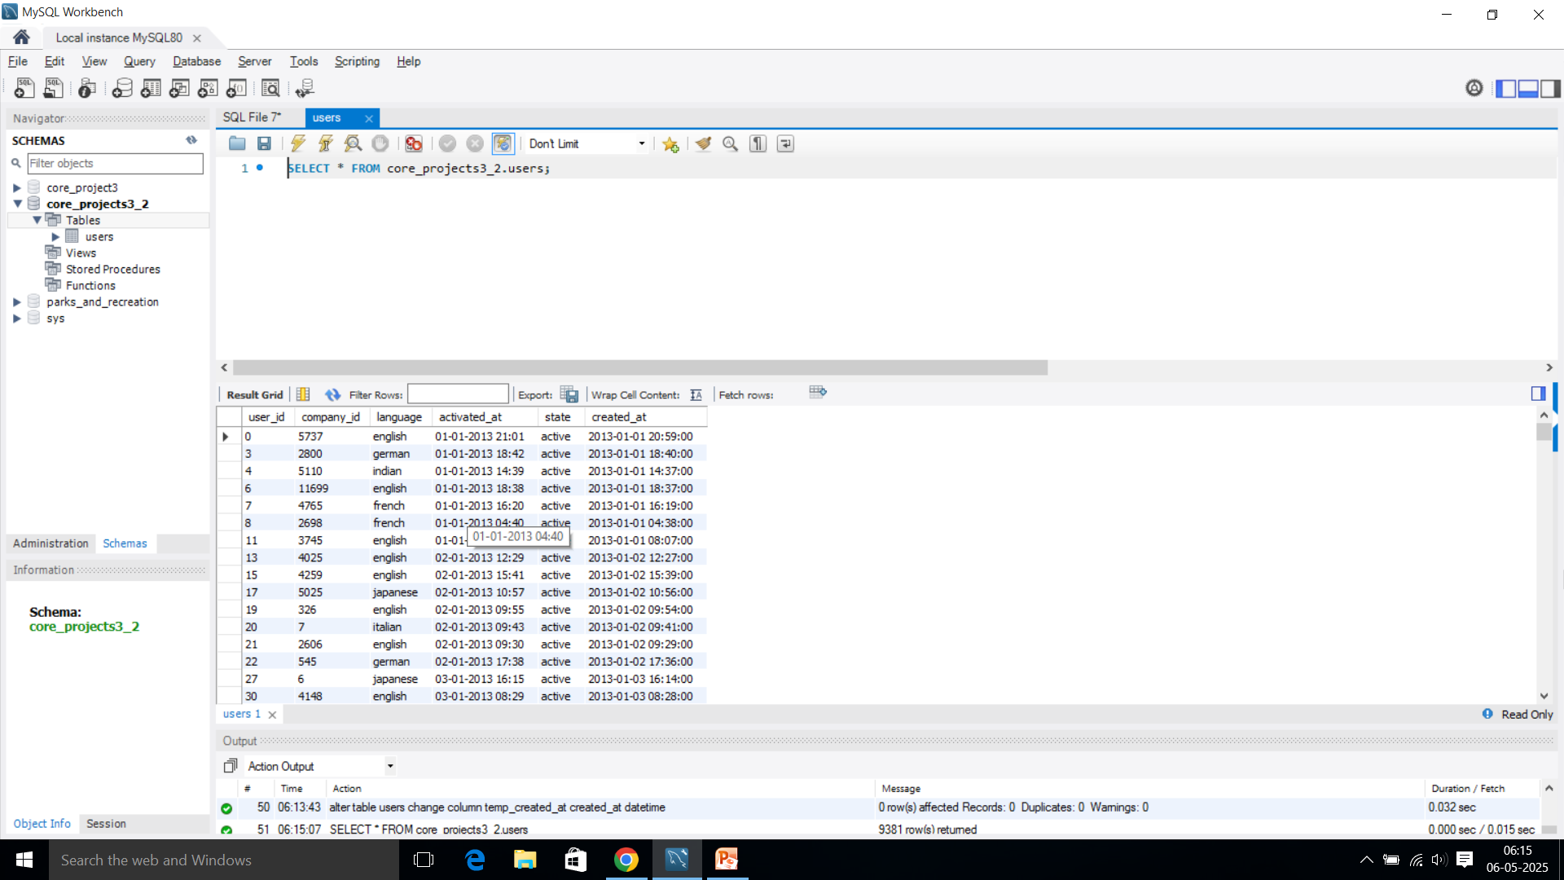
Output:

Slide 22
TABLE-2:

Slide 23
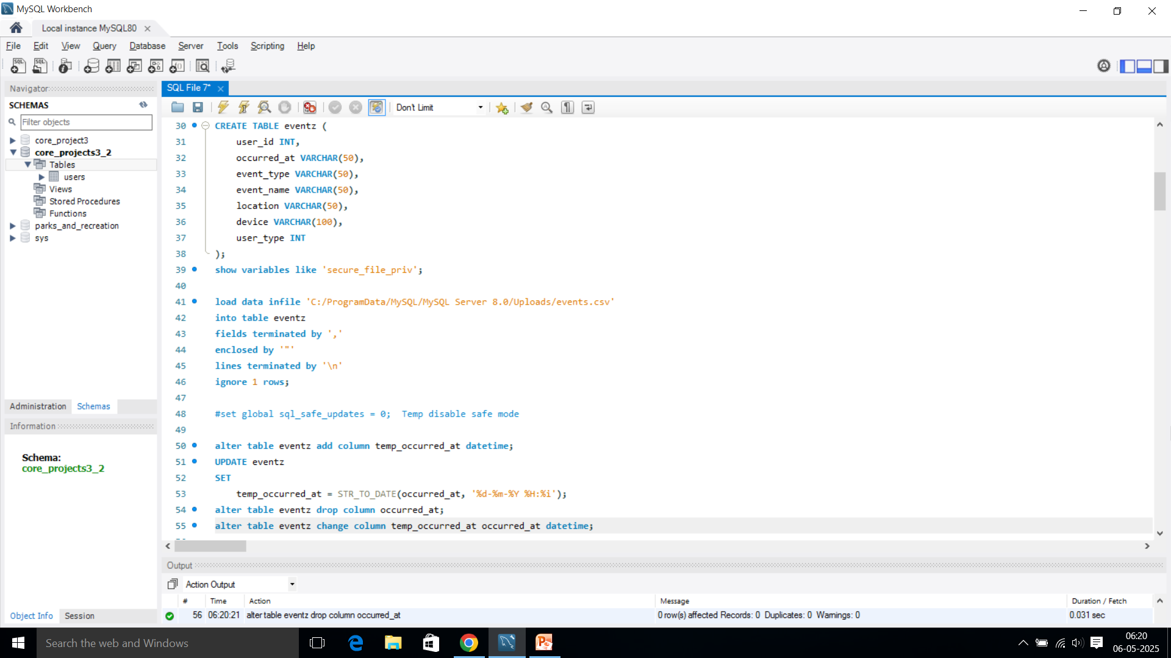
RESULT:
Query:

Slide 24
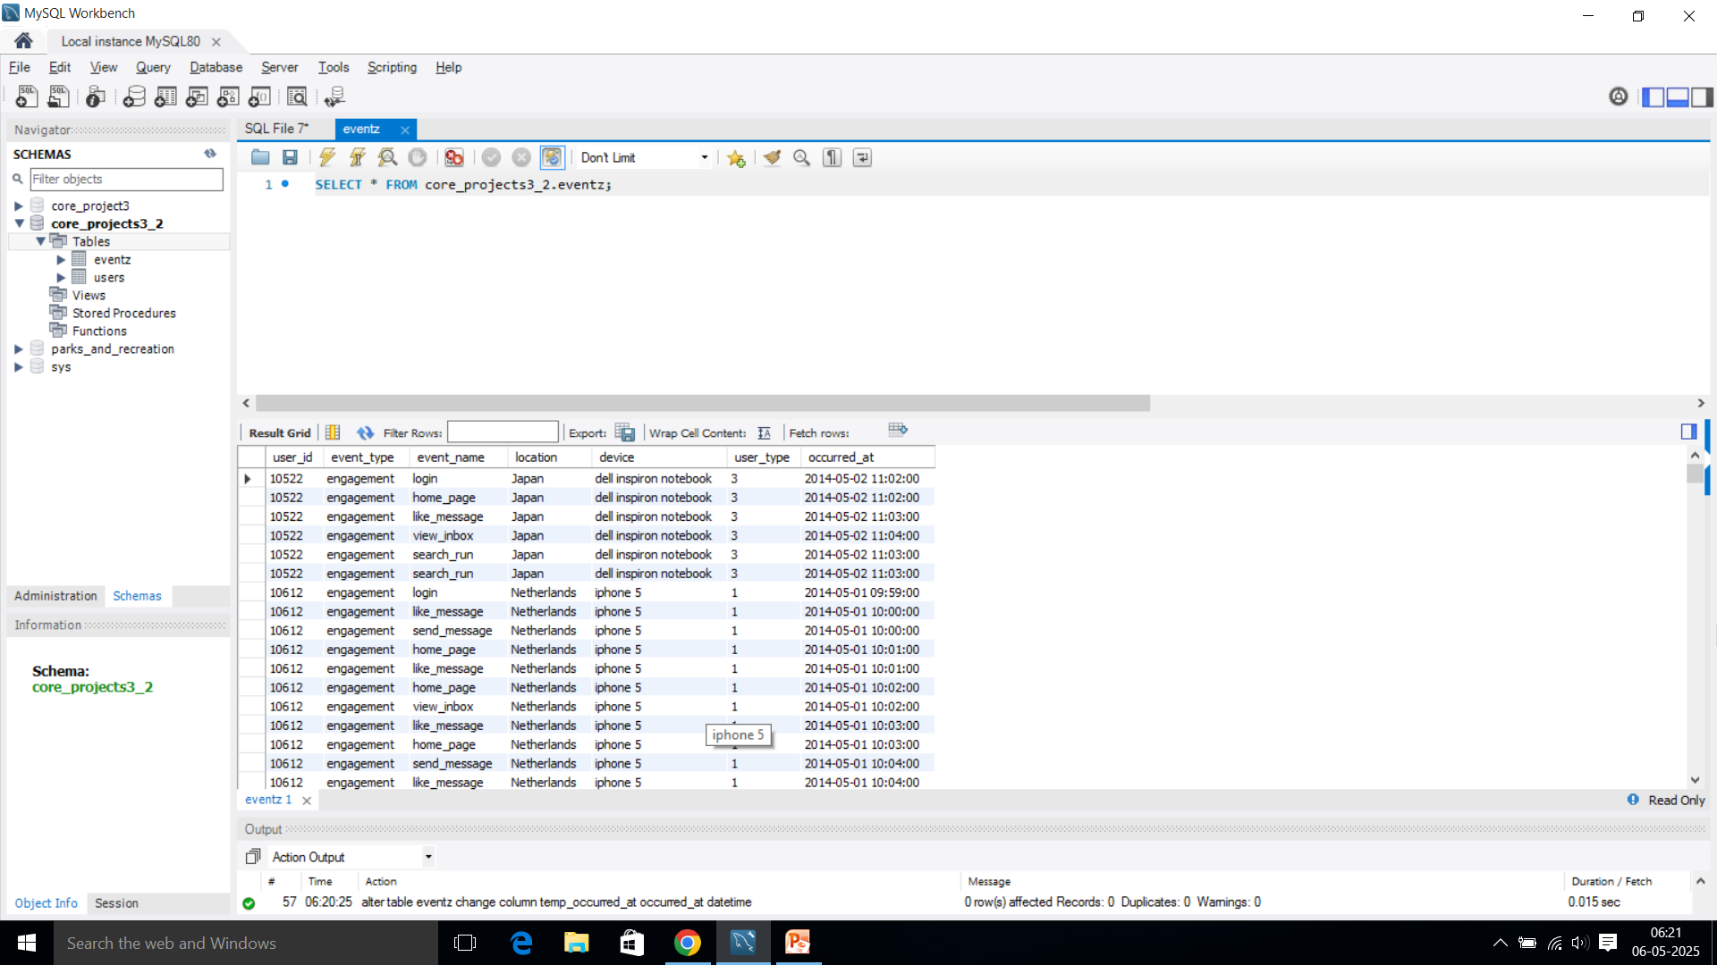
Output:

Slide 25
TABLE-3:

Slide 26
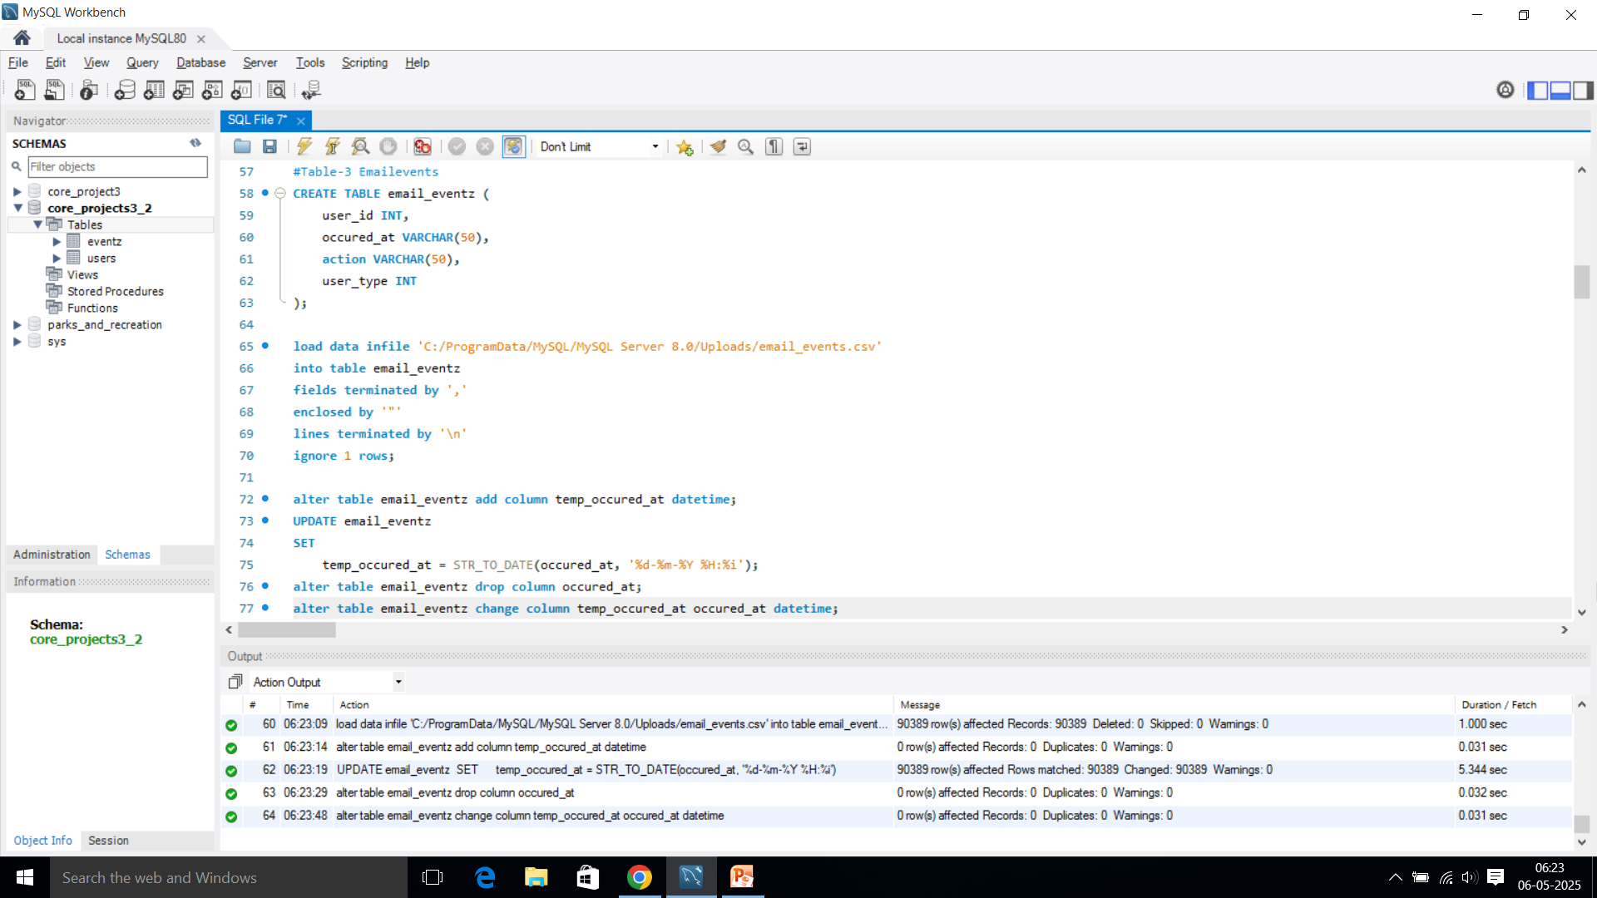
RESULT:
Query:

Slide 27
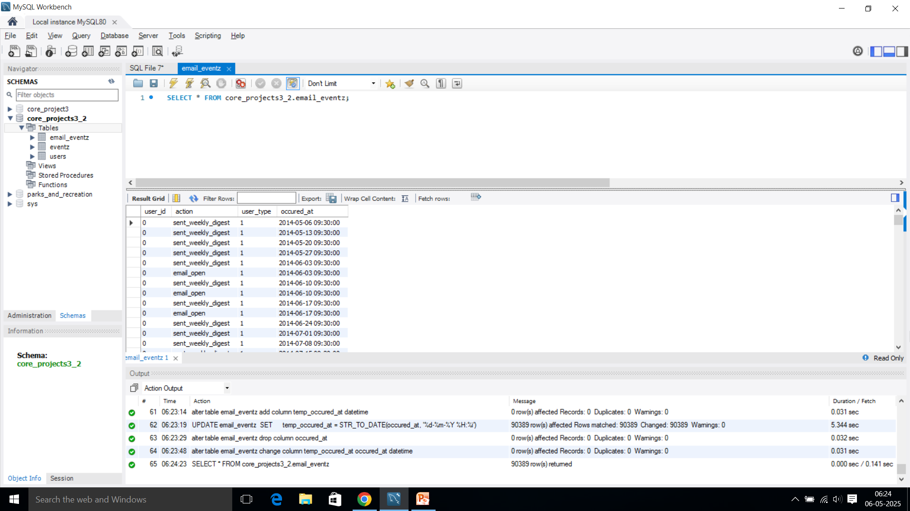
Output:

Slide 28
CASE STUDY 2: TASKS
A. Weekly User Engagement:
Objective: Measure the activeness of users on a weekly basis.
Your Task: Write an SQL query to calculate the weekly user engagement.
SQL Query:
Insight:
The Highest User Week: 30th Week, with 1467 users.
The Minimum User Week: 35th Week, with 104 users.

Slide 29
Result:
week_num | active_users
17 | 663
18 | 1068
19 | 1113
20 | 1154
21 | 1121
22 | 1186
23 | 1232
24 | 1275
25 | 1264
26 | 1302
27 | 1372
28 | 1365
29 | 1376
30 | 1467
31 | 1299
32 | 1225
33 | 1225
34 | 1204
35 | 104

Slide 30
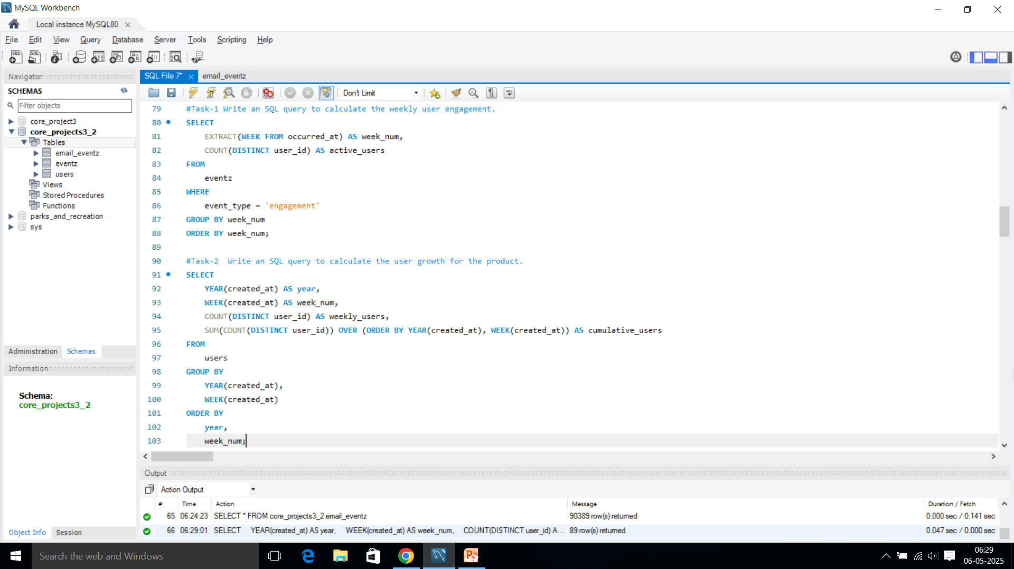
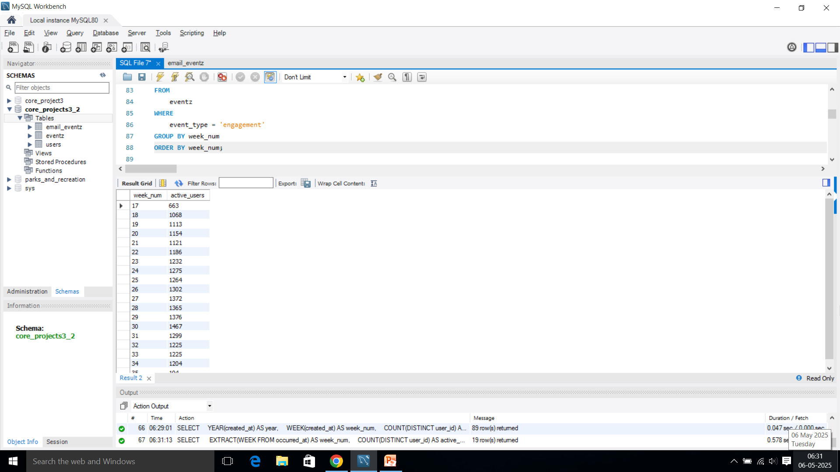
Result:
Query:
Output:

Slide 31
B. User Growth Analysis:
Objective: Analyze the growth of users over time for a product.
Your Task: Write an SQL query to calculate the user growth for the product.
SQL Query:

Slide 32
Result:
year | week_num | weekly_users | cumulative_users
2013 | 0 | 23 | 23
2013 | 1 | 30 | 53
2013 | 2 | 48 | 101
2013 | 3 | 36 | 137
2013 | 4 | 30 | 167
2013 | 5 | 48 | 215
2013 | 6 | 38 | 253
2013 | 7 | 42 | 295
2013 | 8 | 34 | 329
2013 | 9 | 43 | 372
2013 | 10 | 32 | 404
2013 | 11 | 31 | 435
2013 | 12 | 33 | 468
2013 | 13 | 39 | 507
2013 | 14 | 35 | 542
2013 | 15 | 43 | 585
2013 | 16 | 46 | 631
2013 | 17 | 49 | 680
2013 | 18 | 44 | 724
2013 | 19 | 57 | 781

Slide 33
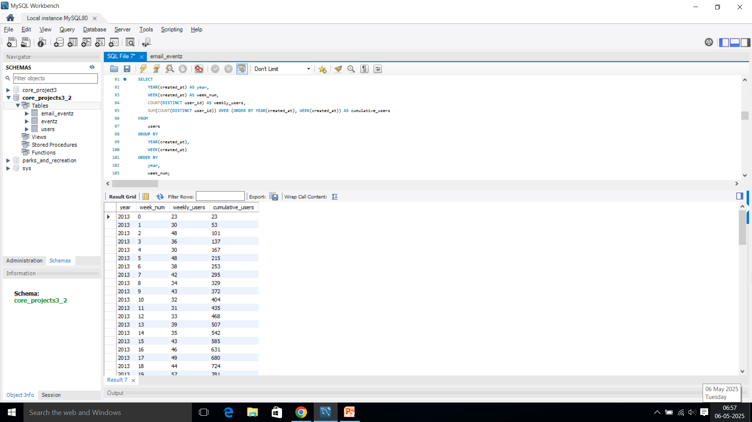
Result:
Query:
Output:

Slide 34
C. Weekly Retention Analysis:
Objective: Analyze the retention of users on a weekly basis after signing up for a product.
Your Task: Write an SQL query to calculate the weekly retention of users based on their sign-up cohort.
SQL Query:

Slide 35
Insights:
The data shown in the table is from the year 2014 and includes data for 35 weeks.
The users who joined in the 17th week show the longest period of user retention (18 weeks).
The 17th week was the largest user sign-up week, with retention up to 18 weeks for 63 users.
The lowest number of users joined in the 35th week, with 145 users.
We can come to a conclusion that there is a flaw relating to customer retention maybe the software, website, product, etc. Which made customers retention rate crash and increased dissatisfaction.

Slide 36
Result:
week_ numbs | week_0 | week_1 | week_2 | week_3 | week_4 | week_5 | week_6 | week_7 | week_8 | week_9 | week_10 | week_11 | week_12 | week_13 | week_14 | week_15 | week_16 | week_17 | week_18
17 | 8091 | 9291 | 6100 | 4890 | 3910 | 3376 | 2900 | 2782 | 2692 | 2743 | 2390 | 2395 | 2391 | 2574 | 2044 | 1464 | 1474 | 1527 | 40
18 | 8213 | 5952 | 4598 | 3391 | 2719 | 2223 | 2329 | 2008 | 1861 | 1823 | 1836 | 1916 | 2093 | 1954 | 1400 | 1412 | 1135 | 37 | 0
19 | 5357 | 4326 | 2756 | 2303 | 1905 | 1658 | 1355 | 1484 | 1409 | 1483 | 1158 | 917 | 826 | 669 | 785 | 805 | 23 | 0 | 0
20 | 4273 | 3340 | 2840 | 1884 | 1413 | 1252 | 953 | 835 | 1029 | 989 | 876 | 549 | 441 | 463 | 450 | 0 | 0 | 0 | 0
21 | 3937 | 3141 | 2213 | 1342 | 1145 | 963 | 955 | 1275 | 822 | 804 | 616 | 567 | 555 | 441 | 17 | 0 | 0 | 0 | 0
22 | 4230 | 3378 | 2506 | 1642 | 1263 | 942 | 1001 | 901 | 851 | 694 | 791 | 679 | 467 | 8 | 0 | 0 | 0 | 0 | 0
23 | 3973 | 3369 | 2064 | 1522 | 1143 | 1041 | 1065 | 824 | 799 | 674 | 412 | 410 | 0 | 0 | 0 | 0 | 0 | 0 | 0
24 | 3882 | 3252 | 2067 | 1613 | 1289 | 911 | 1143 | 913 | 678 | 430 | 384 | 0 | 0 | 0 | 0 | 0 | 0 | 0 | 0
25 | 3439 | 3087 | 2280 | 1639 | 1212 | 816 | 577 | 723 | 536 | 537 | 23 | 0 | 0 | 0 | 0 | 0 | 0 | 0 | 0
26 | 3319 | 3029 | 1552 | 1296 | 933 | 714 | 662 | 548 | 345 | 0 | 0 | 0 | 0 | 0 | 0 | 0 | 0 | 0 | 0
27 | 3684 | 3195 | 1693 | 1553 | 1057 | 806 | 558 | 560 | 12 | 0 | 0 | 0 | 0 | 0 | 0 | 0 | 0 | 0 | 0
28 | 3256 | 3026 | 1854 | 873 | 564 | 388 | 323 | 20 | 0 | 0 | 0 | 0 | 0 | 0 | 0 | 0 | 0 | 0 | 0
29 | 2908 | 3111 | 1688 | 966 | 619 | 639 | 5 | 0 | 0 | 0 | 0 | 0 | 0 | 0 | 0 | 0 | 0 | 0 | 0
30 | 3422 | 2995 | 1727 | 1124 | 696 | 14 | 0 | 0 | 0 | 0 | 0 | 0 | 0 | 0 | 0 | 0 | 0 | 0 | 0
31 | 2450 | 2112 | 906 | 777 | 2 | 0 | 0 | 0 | 0 | 0 | 0 | 0 | 0 | 0 | 0 | 0 | 0 | 0 | 0
32 | 2613 | 2304 | 1085 | 67 | 0 | 0 | 0 | 0 | 0 | 0 | 0 | 0 | 0 | 0 | 0 | 0 | 0 | 0 | 0
33 | 3213 | 2727 | 63 | 0 | 0 | 0 | 0 | 0 | 0 | 0 | 0 | 0 | 0 | 0 | 0 | 0 | 0 | 0 | 0
34 | 3078 | 326 | 0 | 0 | 0 | 0 | 0 | 0 | 0 | 0 | 0 | 0 | 0 | 0 | 0 | 0 | 0 | 0 | 0
35 | 145 | 0 | 0 | 0 | 0 | 0 | 0 | 0 | 0 | 0 | 0 | 0 | 0 | 0 | 0 | 0 | 0 | 0 | 0

Slide 37
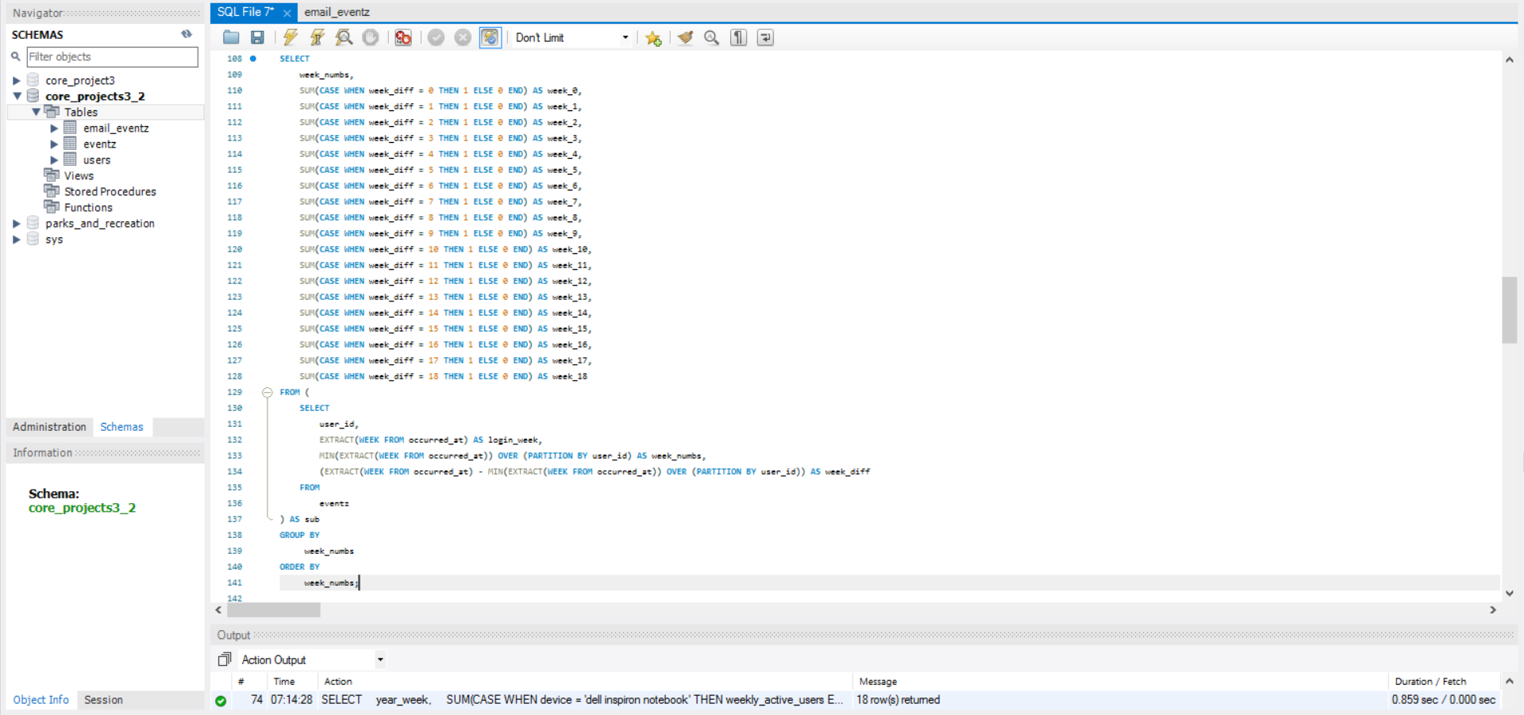
Result:
Query:

Slide 38
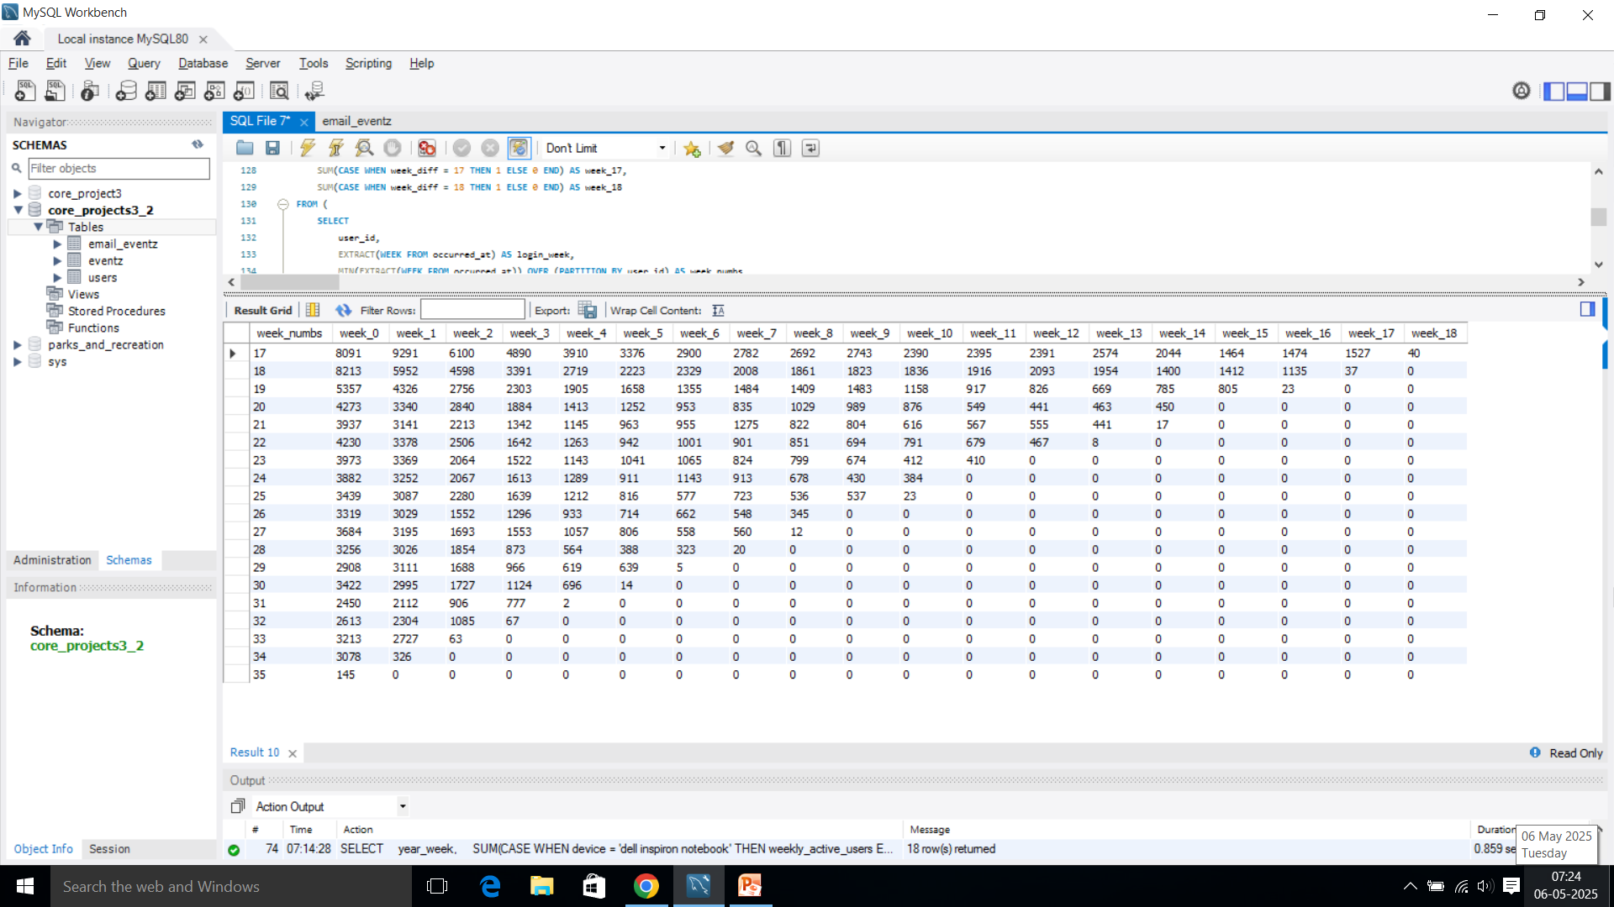
Result:
Output:

Slide 39
D. Weekly Engagement Per Device:
Objective: Measure the activeness of users on a weekly basis per device.
Your Task: Write an SQL query to calculate the weekly engagement per device.
SQL Query:

Slide 40
Insights:
Most people used a Mac Pro (322 users in the 19th week).
Lenovo Thinkpad was the next most popular (220 users in the 28th week).
iPhone 5 was used by 163 people in the 27th week.
Samsung Galaxy Note had the least number of users that is 299 in total.
Kindle fire started off with low users but show a considerable growth compared to Samsung Galaxy Note.
From this we can understand something interesting that focusing on delivering a seamless experience would increase the trust of customers while retaining and show growth.

Slide 41
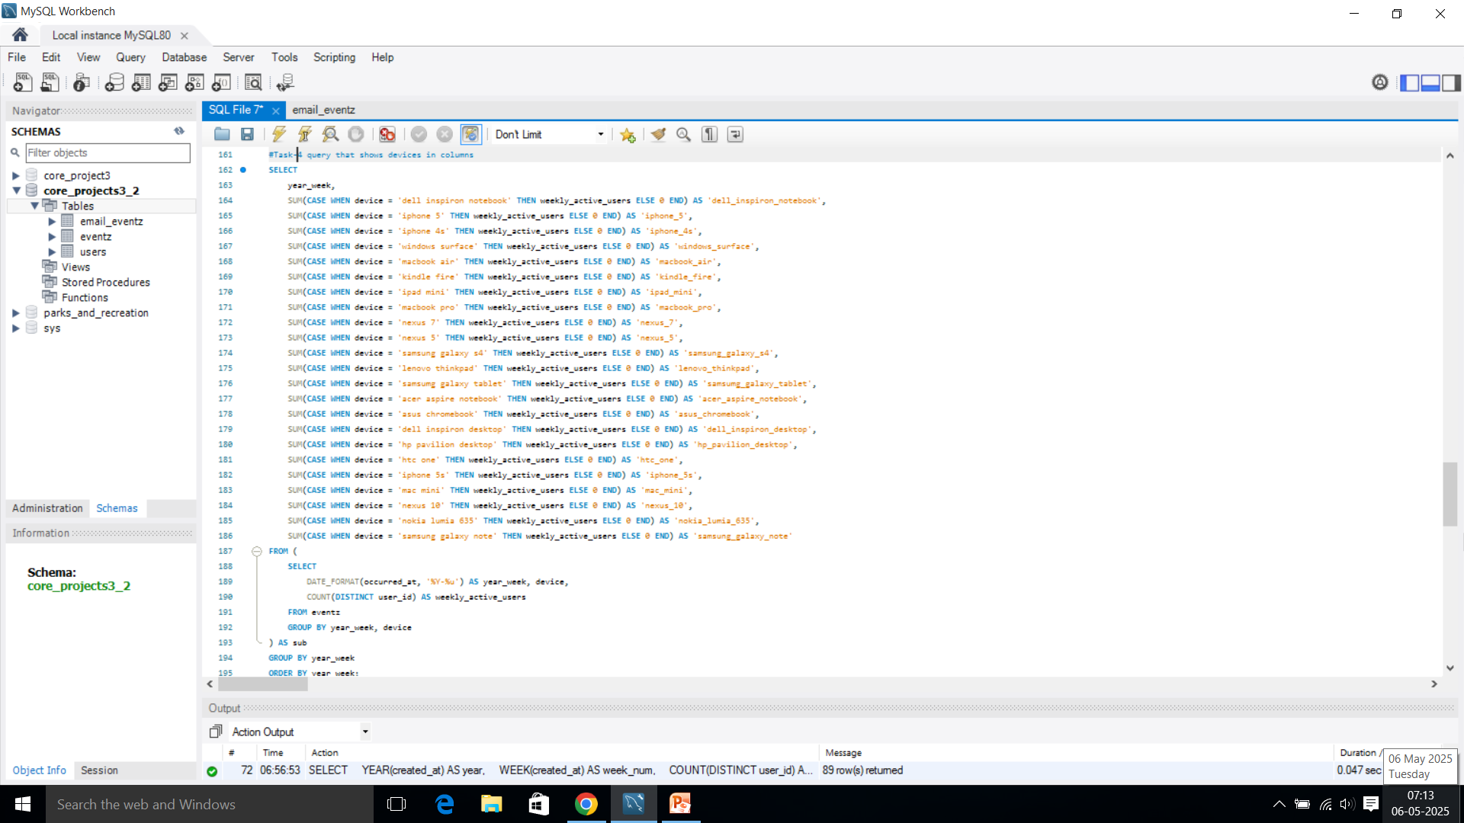
Result:
Query:

Slide 42
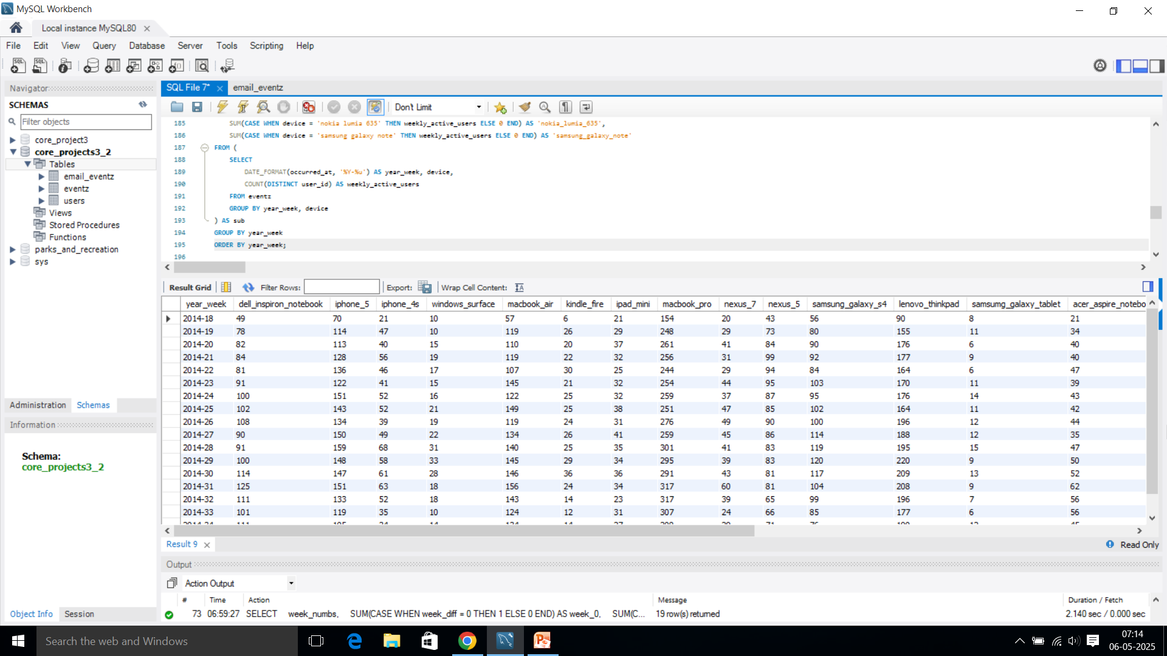
Result:
Output:

Slide 43
E. Email Engagement Analysis:
Objective: Analyze how users are engaging with the email service.
Your Task: Write an SQL query to calculate the email engagement metrics.
SQL Query:

Slide 44
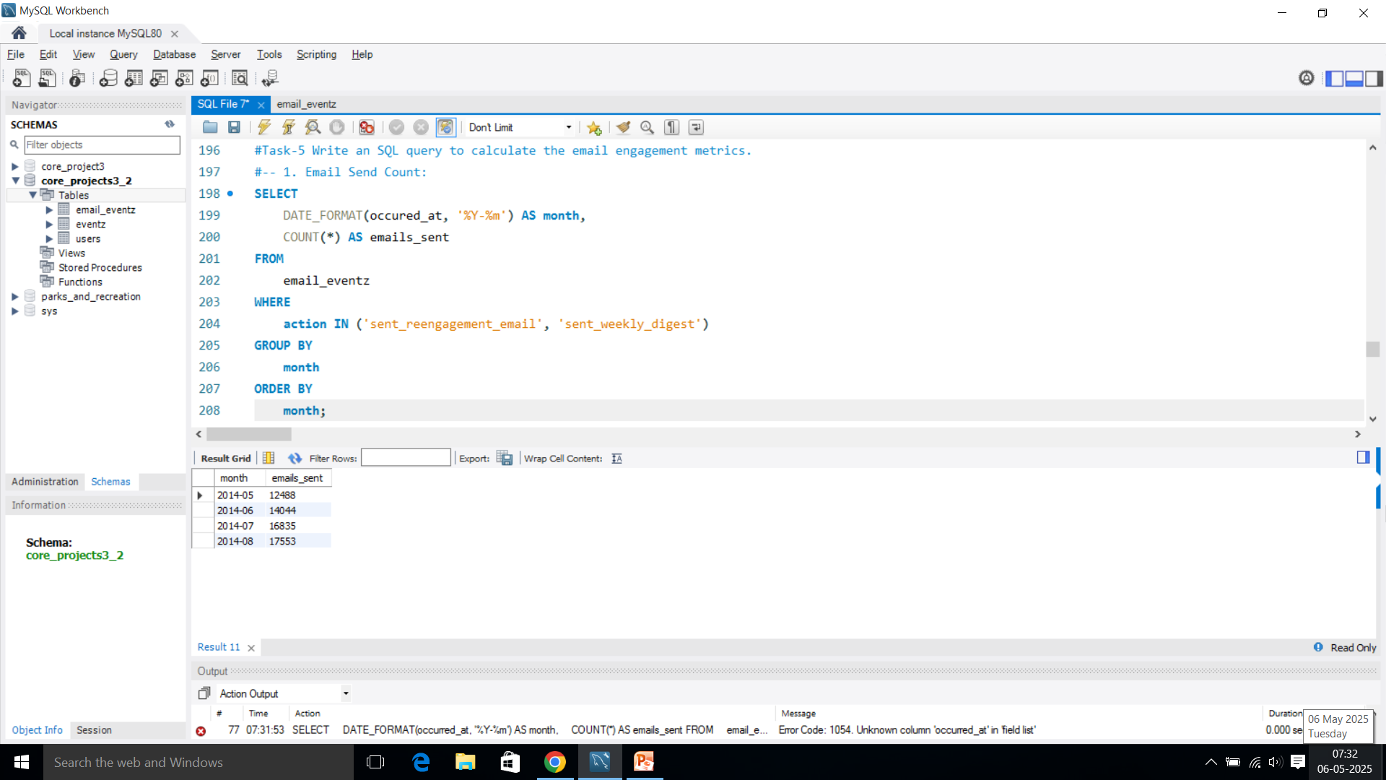
Result:
Output:

Slide 45
SQL Query:

Slide 46
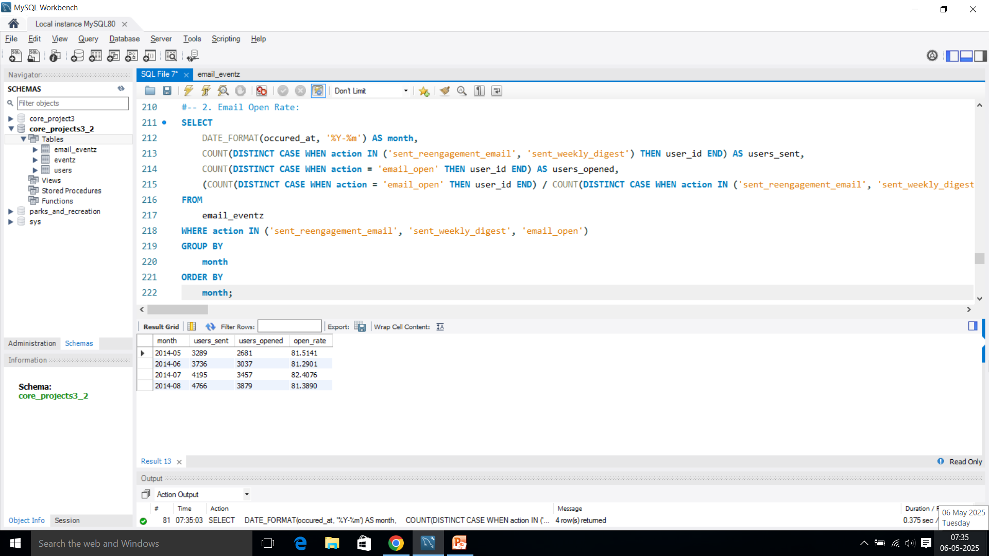
Result:
Output:

Slide 47
SQL Query:

Slide 48
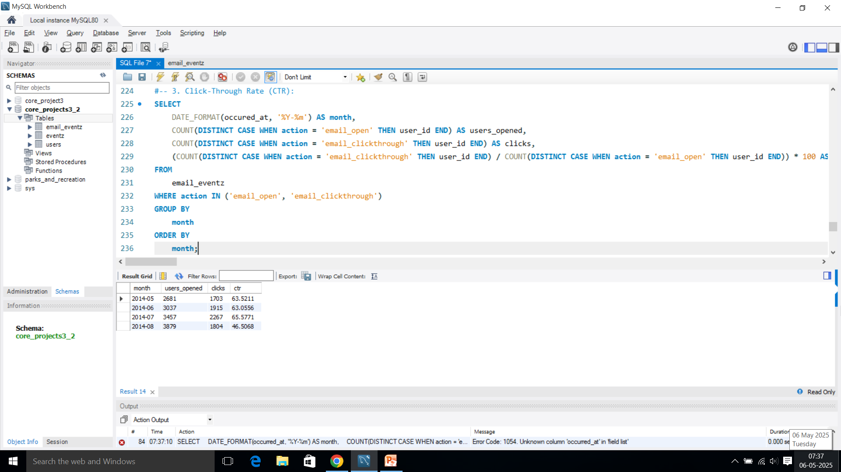
Result:
Output:

Slide 49
SQL Query:

Slide 50
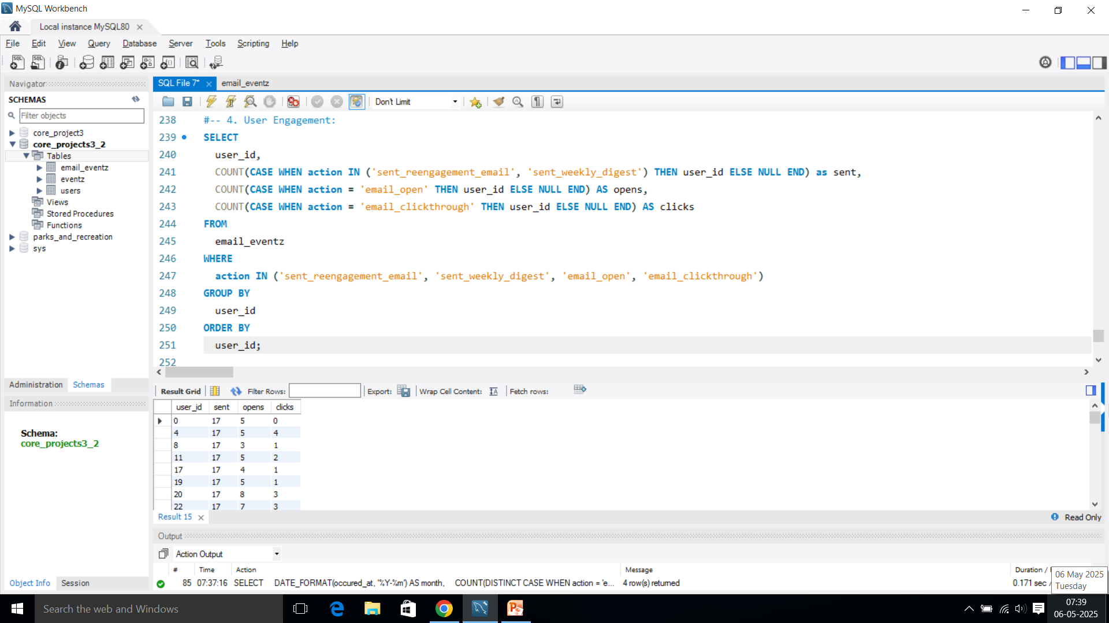
Result:
Output:

Slide 51
SQL Query:

Slide 52
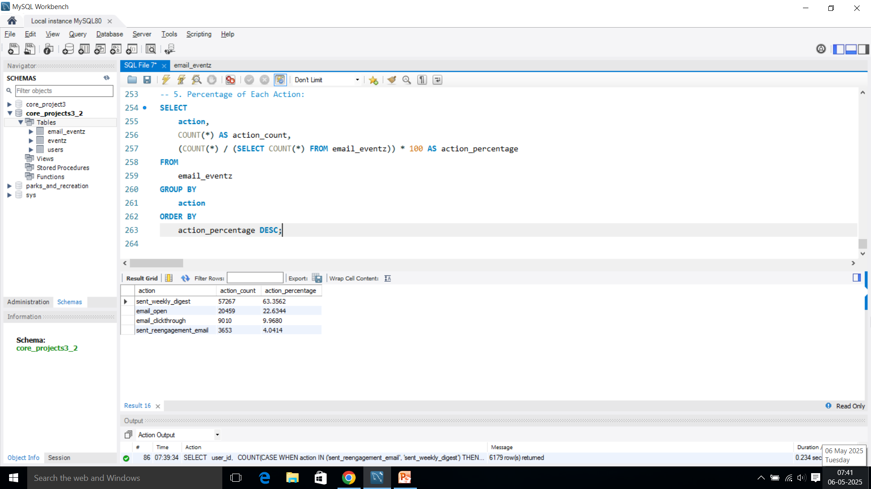
Result:
Output:

Slide 53

Thank You

